Slide 1
Why Do Some Young People Leave The Lord?
Part 2
Some Stay; Some Stray
All verses are from the New King James Version unless noted.
Notes:
We begin part two of this series…
There are young people who are very committed to Christ and do not have to sow wild oats but are content to learn Christ and pursue gaining and building a strong relationship with Him. These are those who come to learn Christ and to learn how to live a better life and secure the hope of heaven.
They do not need to be attracted to the gospel through gimmicks, social gospel efforts, pizza parties and camping retreats. Their attraction is the cross and their love is to Christ for dying for them and providing them wisdom for this life and the pursuit of gaining the eternal life in heaven. Daniel was of such a man. Though taken into Babylonian captivity as a youth, we read that he “purposed” in his heart that he would not defile himself (see Dan. 1:8).
The word “purpose” here means that he “put upon” or “established,” “appointed,” “constituted” “determined,” “set.” Eventually, for anyone to be saved, or to remain saved, young or old, they must have that Daniel like determination. There was a pressure applied to Daniel to compromise his belief, to break the law of God which he had so as to please the chief Eunuch and the King. Not just any king, but Nebuchadnezzar (5:18, 19).

Slide 2




Not Uncommon For Young People
Lose interest in spiritual matters
Pull away – become “distant”
Start missing some – then quit attending
Date, engaged & marry non-Christian
Involvement in alcohol or drugs
Ultimately Lose Them To The World!

Slide 3
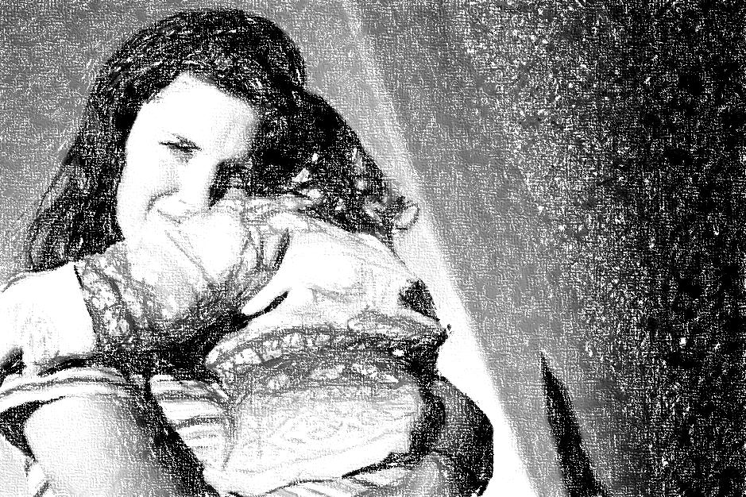
Why Are We Losing Our Young People
I. Bad Influence – of their Friends
II. Poor Example – of their Parents
Notes:
In the last lesson we looked at the bad influence which friends can bring upon friends. Younger worldly peers likely have a greater impact on bringing their peers down than vice versa. “The righteous should choose his friends carefully, For the way of the wicked leads them astray” (Prov. 12:26).
Today… parental influence. We cannot under estimate the power of parental influence for good or evil. We are not as neutral and powerless as we may like to think we are. What is our example teaching our children?
NOTE CAREFULLY,
Pr 17:21, “He who begets a scoffer does so to his sorrow, And the father of a fool has no joy.”

Slide 4
II. Poor Example – of their Parents
A. Young People Learn From What They See
  General principle (Matt. 5:13-16; 1 Tim. 4:12)
  Become like parents (Prov. 20:7; Ez. 16:44, 45)
  Actions speak louder than words; parental conduct influences!
Notes:
“The righteous man walks in his integrity; His children are blessed after him” (Prov. 20:7).
RE: Ezek. 16:44, 45 –the proverb, “Like mother, like daughter” is a proverb because of the power of influence that parents have over their children. The daughter often learns from her mother’s manners and learns to repeat them in her own life. If she is loud and overbearing, then she will likely be the same. If she is mild, meek and quiet, then her daughter will likely be the same. If she disrespects her husband, then her daughter will likely be the same. Jerusalem despised her husband and behaved in the way of the Canaanites.
It would be insulting to refer to Jerusalem as having Abraham as their father, because these people were walking in the way of the Gentiles of the land and not like Abraham (16:3). We see here that their spiritual walk, conduct and decision making is what constitutes and defines whose children they are of (cf. Jn. 8:39-47; Rom. 2:28, 29).

Slide 5
II. Poor Example – of their Parents
A. Young People Learn From What They See
B. Young People Often See Parents Who:
1. Didn’t go to Bible Class
2. Placed family gatherings over spiritual
3. Didn’t attend on Wednesday nights
4. Miss a lot when “too tired” and “don’t feel good”
5. Regularly miss services for work
6. Placed emphasis on material over spiritual
7. Placed emphasis on school over spiritual
8. Make decisions promoting worldliness
Don’t Be Surprised
When They Turn Out Just Like You Trained Them!

Slide 6
II. Poor Example – of their Parents
A. Young People Learn From What They See
B. Young People Often See Parents Who:
1. Prepare for and attend Bible class
2. Placed spiritual matters above others
3. Attend midweek services
4. Even attend when feeling tired
5. Excuse themselves from other things for
worship and Bible study
6. Emphasize Biblical education over secular
7. Frequently engage in family discussions
concerning Biblical doctrine and conduct
Rejoice When They Turn Out Just Like You
Trained Them (Prov. 23:15, 16, 24)!
Notes:
Proverbs 23:24 is the goal!

Slide 7


GOAL?
24 The father of the righteous will greatly rejoice, And he who begets a wise child will delight in him.
25 Let your father and your mother be glad, And let her who bore you rejoice.
26 My son, give me your heart, And let your eyes observe my ways.
Very Important
Important
Somewhat Important
A Little Important
Notes:
The father here wants a wise son, one whom he can delight in and bring happiness to the parents. He wants one who will give him his heart and eyes. While I think we all want a wise children, how important is it to us as parents to have righteous and wise children? What level of importance do we ascribe to this goal?
Big goals mean a lot? Big goals are not gained with little work. How big is it for you to have a son that is wise (cf. 23:15, 16)?
If you attain for yourself a great education (a doctorate) but have a foolish child how much happiness would that doctorate provide you then? Is there any happiness in securing a great paying job, living in the house of your dreams, and driving a hummer if have raised a bummer, a foolish and careless child that does not fear God?
If we want our children to give us their hearts, doesn’t it make sense to give them our heart first (Titus 2:4). Doesn’t it make sense that for them to have a heart after God when they are older, we must give them the heart of God when they are younger? We do that by modeling God before them.
I think we often shoot for our dreams and our dreams are a great education, a great job, owning our own house, getting out of debt, securing a retirement package, etc. But, where exactly does having wise children come in on the list? How happy will you be when you are old and your children and their children are still not Christians? How much comfort do unbelieving children provide their aging parents?
If having wise children and grandchildren is a goal, then what are you doing to attain that goal? It cannot be just a dream. A dream is just a dream. A goal is a dream with a plan. What have you done? Are you satisfied with what you have attained. Lessons on “How Can Fathers Be Good Leaders” (1, 2) discusses material associated with the goal in this passage.

Slide 8
II. Poor Example – of their Parents
A. Young People Learn From What They See
B. Young People Often See Parents
C. Young People Will Likely Exploit Permissive
Parents
1. Godly parents control their house
(Prov. 23:13, 14; 1 Tim. 3:4,12)
2. Permissive parents do not restrain children
(1 Sam. 3:13; 1 Kin.1:6; result → Prov. 29:15)
Contrast, Prov. 29:17
Notes:
Note marg. Reference 1 Kin. 1:6, “pained” for “rebuked.” The permissive parent may not want his child to engage in certain behavior. That is not ruling and restraining the house. The type of parent that God desires men to be is to restrain and pain children, even adult children who are disobedient. This pain obviously doesn’t come in the form of a spanking to an adult son, but rather in the form of sharp disapproval for his conduct.
RE: Prov. 29:15 Note that when a mother obstructs the rod and rebuke to her children, she receives dishonor and shame. Children need to learn early that parents have love and authority and that their love is often displayed by the way they use their authority. If a child disrespects and does not appreciate parental authority, it is also natural for him to not love and appreciate mom and dad (Prov. 30:11). “A wise son makes a father glad, But a foolish man despises his mother” (Prov. 15:20). Permissive parental oversight is no oversight in reality and erodes away the place for love and respect.

Slide 9
II. Poor Example – of their Parents
A. Young People Learn From What They See
B. Young People Often See Parents
C. Young People Will Likely Exploit Permissive
Parents
D. Young People Need Teaching and Training
1. In every venue that time permits (Deut. 6:7)
2. What you train in the home will likely be what
leaves the home (Prov. 22:6)
3. Hypocrisy is a turnoff (Ps. 50:16-23)
Notes:
Will have more to say about training in the next lesson.
RE: Ps. 50:16-23 note how sometimes those who are wicked seek to declare God’s law and speak His covenant. They have no right to utter His words. It is a turnoff to God and men. Where does the gossip and slanderer get the right to lecture me about brotherly love and compassion? Where does the brother who gets mad and rants and raves when his sin is exposed get the right to tell someone he must follow Matthew 18 in correcting another?
Where does the one who approves of dirty dancing get the right to lecture me about what is proper, what is modest, or what action is right in any matter? Shall the adulterer preach God’s law on divorce? Only if he truly repented! Any person, child or adult can see the sick disparity, hypocrisy and inconsistency. When parents bite and devour the preacher/teacher, children see that their parents are simply “playing church” and it is only natural for them to be turned off to it.

Slide 10
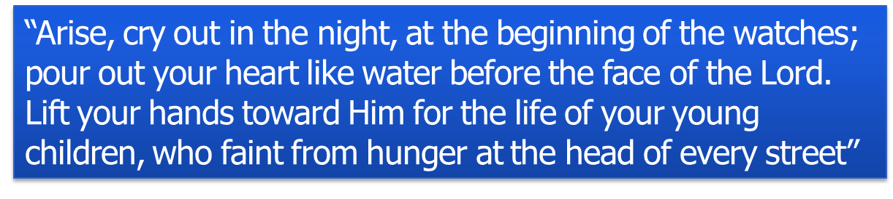
II. Poor Example – of their Parents
A. Young People Learn From What They See
B. Young People Often See Parents
C. Young People Will Likely Exploit Permissive
Parents
D. Young People Need Teaching and Training
E. Young People Need Parents To Pray For
Them
Lam. 2:19

Slide 11
Why Are We Losing Our Young People
I. Bad Influence – of their Friends
II. Poor Example – of their Parents
Next Lesson
III. Weak Image – of the Church

